Slide 1
Improving Interpersonal skills in the workplace

Slide 2
Welcome!
Please take the time to take the DiSC Assessment Test sent to your emails.

Slide 3
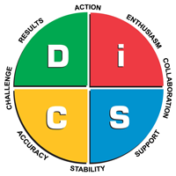
Disc Assessment
DISC is a personal assessment tool for improving productivity, teamwork and communication. It deals exclusively with modes of behavior and communication.

Slide 4
The Wheel

Slide 5
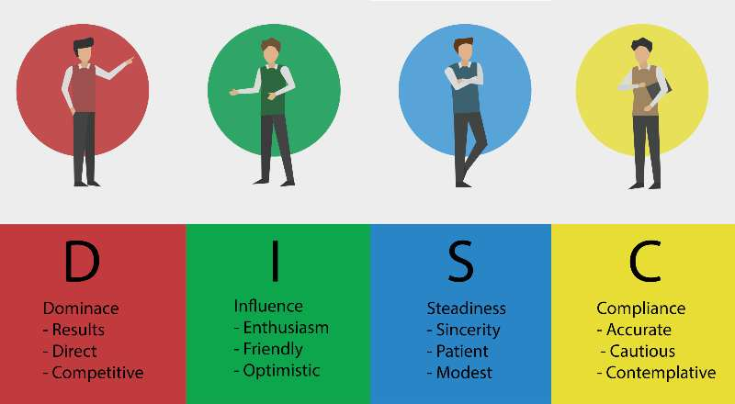
DiSC Profiles

Slide 6
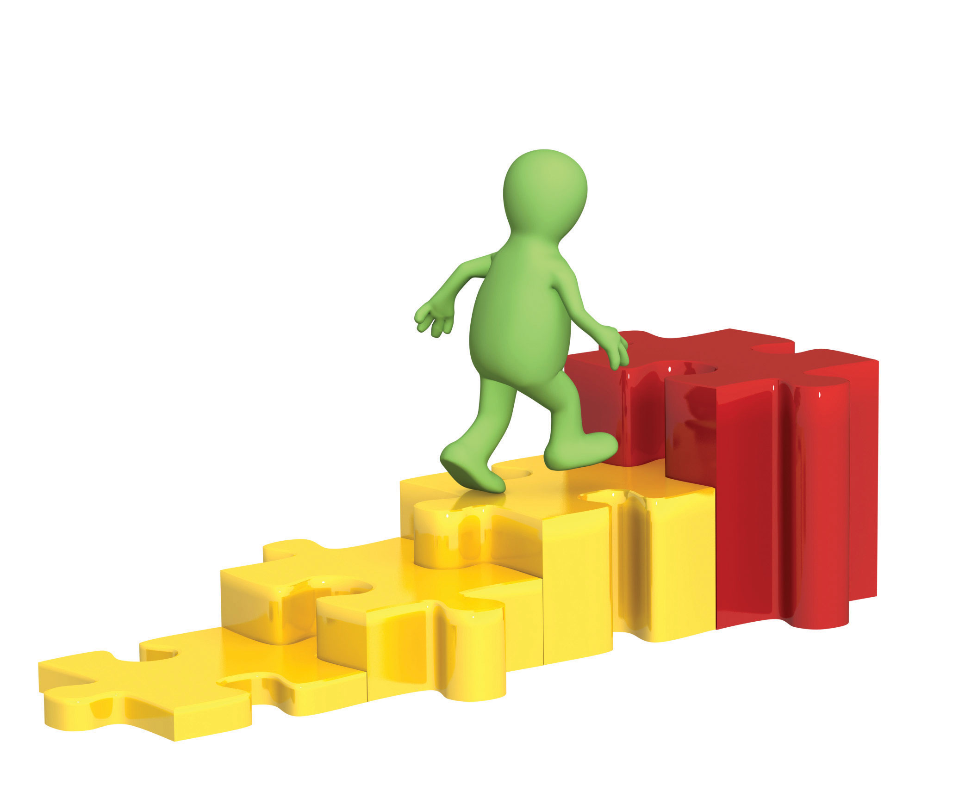
Course Purpose
To improve interpersonal communication in the office.

Slide 7
Prior knowledge
What did you learn about yourself from the DISC assessment?

Slide 8
Why interpersonal skills matter
They help you stand out from the crowd, whether it is in a college group activity or job interview. They complement your technical abilities, enhance performance, boost social interactions, and give you an edge over your competition.

Slide 9
Interpersonal Communication
Interpersonal Communication is the process by which people exchange information through verbal and non-verbal messages
Interpersonal Skills also include:
Ability to listen and understand
Conflict management
Problem solving
Decision making
Stress management

Slide 10
Importance of Interpersonal Communication
Interpersonal skills are life soft skills. They help maintain relationships within the organization and on a personal level (with family and friends).

Slide 11
What are soft skills?
Personal attributes that enable someone to interact effectively and harmoniously with other people;
A combination of people skills, social skills, communication skills, character traits, attitudes, career attributes, social intelligence and emotional intelligence quotients among others that enable people to navigate their environment, work well with others, perform well, and achieve their goals with complementing hard skills.

Slide 12
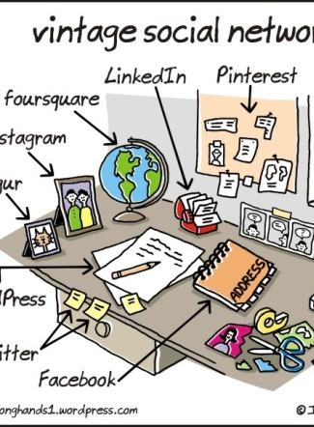
Interpersonal Skills
Personal Skills
Listening
Creativity
Conflict Management
Dealing with Difficult People

Slide 13
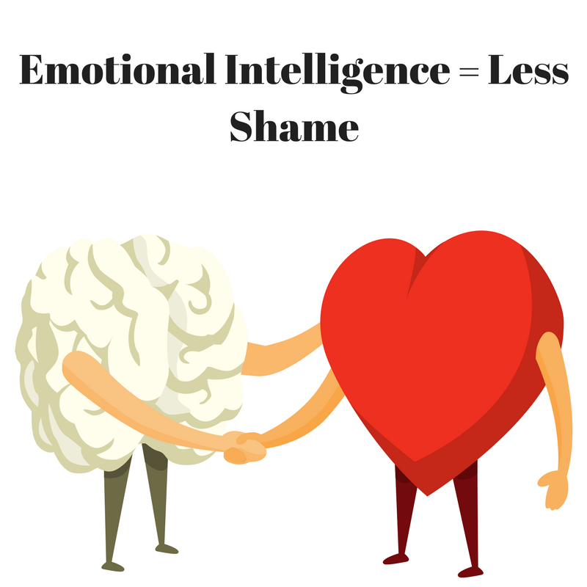
Personal Skills
Emotional Intelligence
Self Awareness
Emotion Management
Stress Management
Tolerance of Change and Uncertainty
Taking Criticism
Self Confidence
Adaptability
Resilience
Assertiveness
Competitiveness
Self Leadership
Self Assessment
Work-Life Balance
Friendliness
Enthusiasm
Empathy

Slide 14
Listening Skills
Listening is more important than just verbal communication
Listening is not the same as hearing
Listening is about paying attention, not only to the story, but how it is told, the use of language and voice, and how the other person uses their body to communicate.
Listening requires you to use your other senses in addition to hearing the spoken language.

Slide 15
Creativity
Problem Solving
Critical Thinking
Innovation
Troubleshooting
Design Sense
Artistic Sense

Slide 16
Conflicts in the Workplace
There are five main causes of conflict: information conflicts, values conflicts, interest conflicts, relationship conflicts, and structural conflicts.

Slide 17
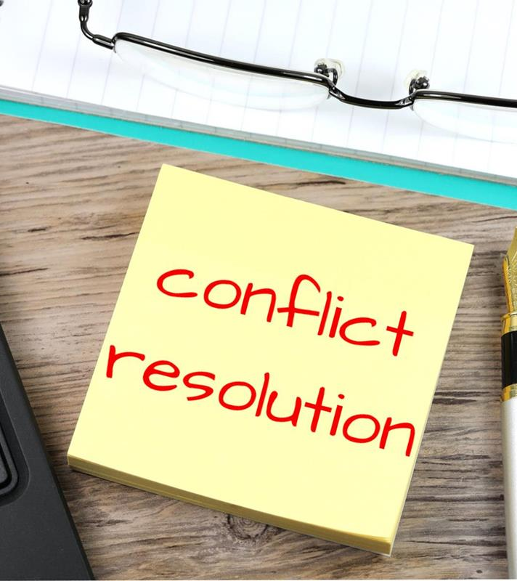
Information Conflicts
Information conflicts arise when people have different or insufficient information or disagree over what data is relevant. Allowing sufficient time to be heard, in a respectful environment facilitated by a neutral person can allow parties to clear up information disparities.

Slide 18
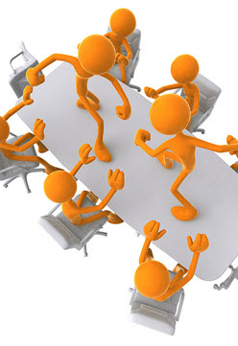
Values conflicts
Values conflicts are created when people have perceived or actual incompatible belief systems. Where a person or group tries to impose its values on others or claims exclusive right to a set of values, disputes arise. While values may be non-negotiable, they can be discussed, and people can learn to live peacefully and coherently alongside each other.

Slide 19
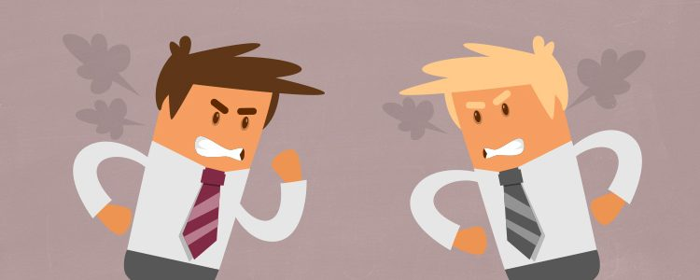
Interest conflicts
Interest conflicts are caused by competition over perceived or actual incompatible needs. Such conflicts may occur over issues of money, resources, or time. Parties often mistakenly believe that in order to satisfy their own needs, those of their opponent must be sacrificed. A mediator can help identify ways to dovetail interests and create opportunities for mutual gain.

Slide 20
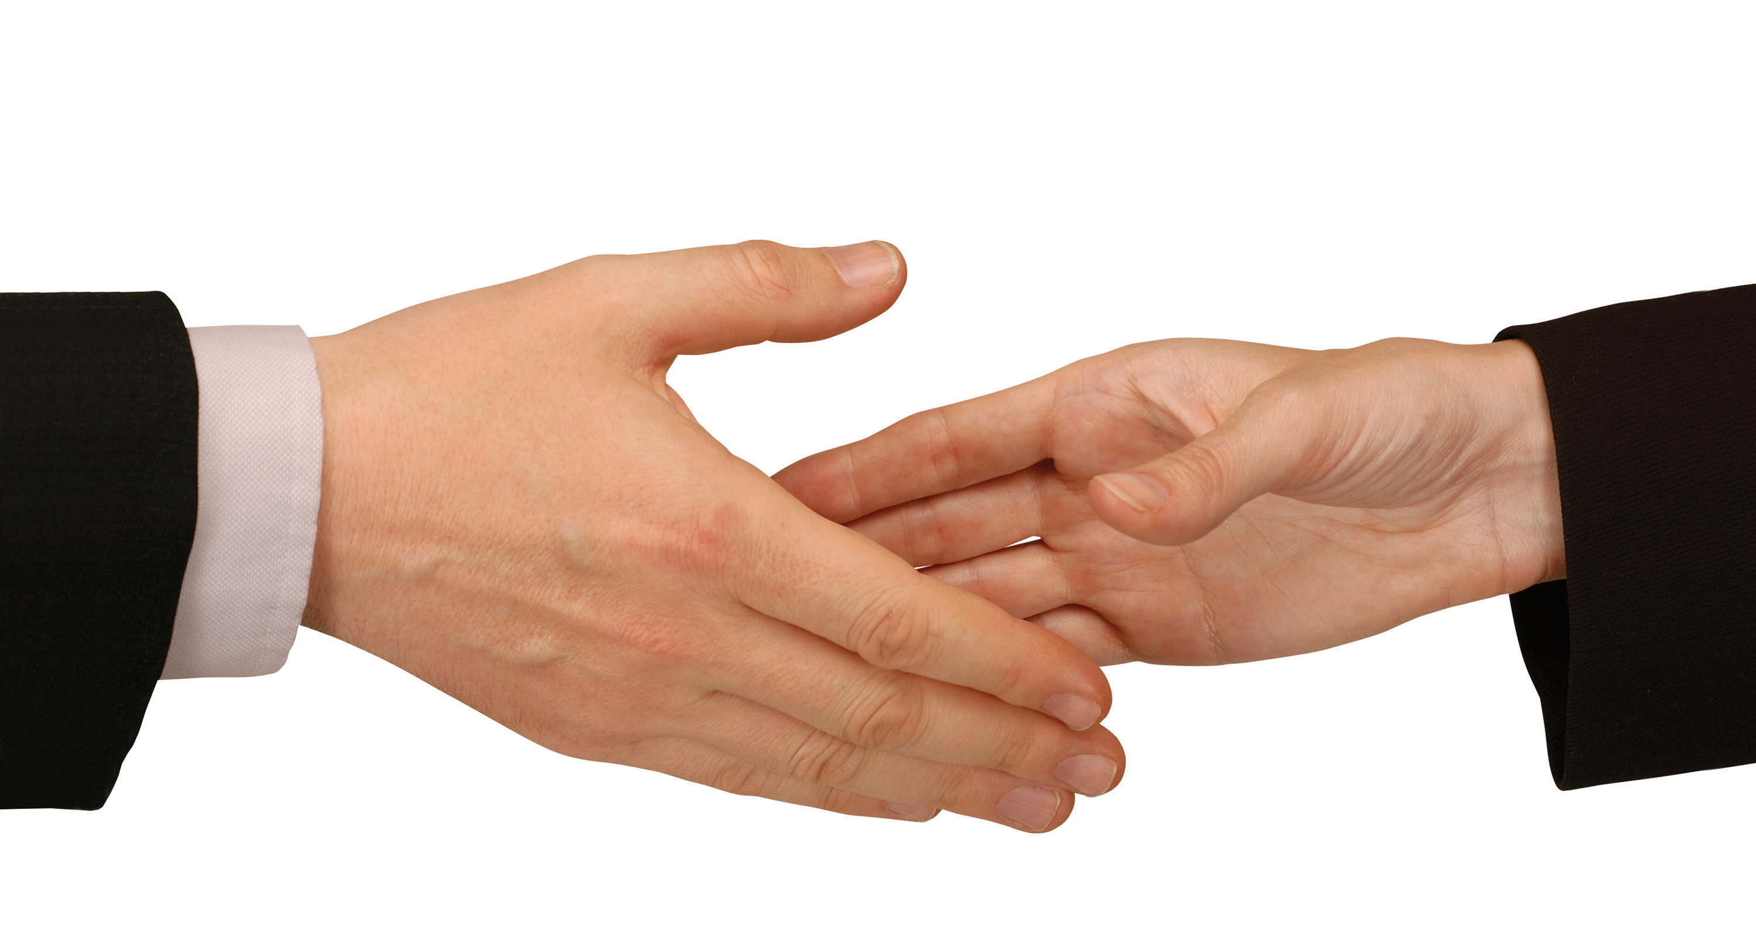
Relationship conflicts
Relationship conflicts occur when there are misperceptions, strong negative emotions, or poor communication. One person may distrust the other and believe that the other person’s actions are motivated by malice or an intent to harm the other. Relationship conflicts may be addressed by allowing each person uninterrupted time to talk through the issues and respond to the other person’s concerns.

Slide 21
Structural conflicts
Structural conflicts are caused by oppressive behaviors exerted on others. Limited resources or opportunity as well as organization structures often promote conflict behavior. The parties may well benefit from mediation since the forum will help neutralize the power imbalance.

Slide 22
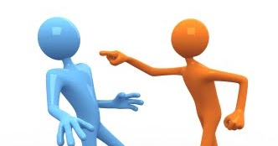
Conflict Management Techniques
There are Five Major Conflict Management Styles. Knowing when and how to use each style can help control conflict and lead to an improved working environment, resulting in a better bottom line.

Slide 23
1. Collaborating Style
Collaborating Style: A combination of being assertive and cooperative, those who collaborate attempt to work with others to identify a solution that fully satisfies everyone’s concerns. In this style, which is the opposite of avoiding, both sides can get what they want, and negative feelings are minimized.
Collaborating works best when the long-term relationship and outcome are important—for example, planning for integrating two departments into one, where you want the best of both in the newly formed department.

Slide 24
2. Competing Style
Competing Style: Those who compete are assertive and uncooperative and willing to pursue one’s own concerns at another person’s expense.
Using this style works when you don’t care about the relationship, but the outcome is important, such as when competing with another company for a new client.
Don’t use competing inside the organization. It does NOT build relationships.

Slide 25
3. Avoiding Style
Avoiding Style: Those who avoid conflict tend to be unassertive and uncooperative while diplomatically sidestepping an issue or simply withdrawing from a threatening situation. “
Use this when it is safer to postpone dealing with the situation or you don’t have as great a concern about the outcome, such as if you have a conflict with a co-worker about their ethics of using FaceTime on the job.

Slide 26
4. Accommodating Style
Accommodating Style: The opposite of competing, there is an element of self-sacrifice when accommodating to satisfy the other person. While it may seem generous, it could take advantage of the weak and cause resentment.
You can use accommodating when you really don’t care a lot about the outcome but do want to preserve or build the relationship. Such as going out for lunch with the boss and agreeing.

Slide 27
5. Compromising Style
Compromising Style: This style aims to find an expedient, mutually acceptable solution that partially satisfies both parties in the conflict while maintaining some assertiveness and cooperativeness.
This style is best to use when the outcome is not crucial and you are losing time; for example, when you want to just make a decision and move on to more important things and are willing to give a little to get the decision made.

Slide 28
Dealing with difficult people
Be calm
Understand the person’s intentions
Let the person know where you’re coming from
Get perspective from others
Treat the person with respect
Ignore
If all fails:
Escalate to higher authority or management

Slide 29
Thank you!

